Slide 1
Import JSON
Import JSON

Slide 2
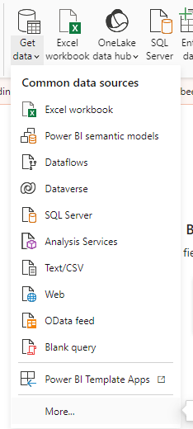
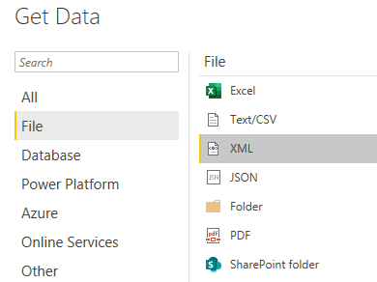
Importing JSON
Note: This Lab uses the CustomerOrder.json file located in the resources / JsonSources folder
Select JSON as data source
2
1

Slide 3
Importing JSON
Start by opening the file Example1.json in the text editor notepad ++ and observe the structure of the file
Note that the Colors element is of type array
Open the file Example2.json and notice that the structure differs from Example1.json
Open the Example3.json file and notice that the structure differs again from the previous two files.
Open the file Example4.json and observe that there is a similarity with the contents of Example2.json but the elements represent lites rather than scalar values
Select JSON as data source and try to load the first file into the Power Query , and notice that the data is represented as records

Slide 4
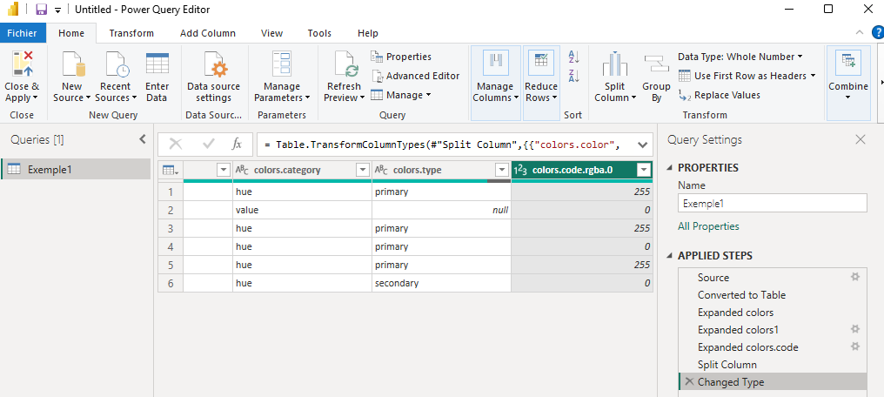
Importing JSON
Keep only Source and suppress the rest of the steps

Slide 5
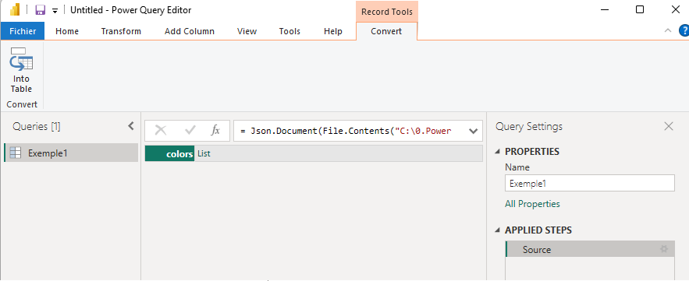


Importing JSON
Click Into Table
Click in the icon
to expand the list
1
Creates each data
In separate row
2
Creates multiple data
In one row with separator like comma or
Semi colon

Slide 6
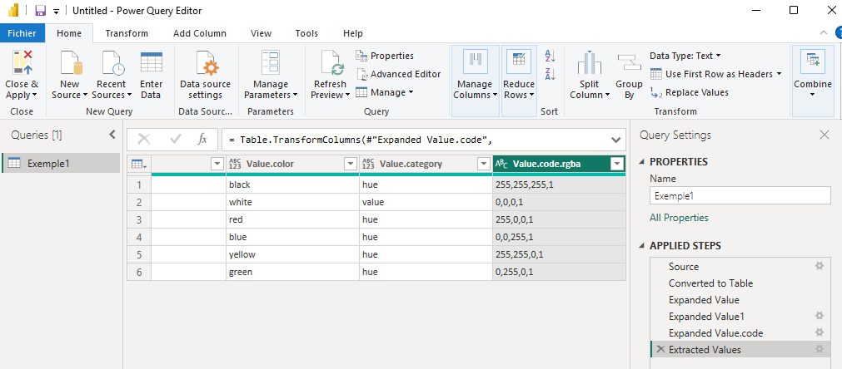
Importing JSON
This for example kind of data structure

Slide 7
Thank you
Thank you

